Slide 1
Should Game Management Unit (GMU) 14 be Converted From Over-the-Counter (OTC) Licensing to a Limited License Unit for Archery Elk Hunting?
Colorado Parks and Wildlife
Area 10 Staff
Steamboat Springs, CO

Slide 2
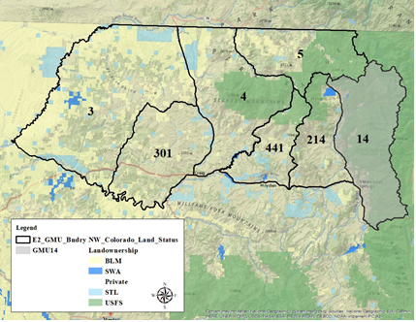
GMU 14 – Bear’s Ears (E-2) DAU

Slide 3
Issues
Biological Reasons
  Decreasing number of elk classified
  Decreasing calf:cow ratio
  Increasing bull:cow ratio
  Decreasing harvest trend
Social Overcrowding
  Increased amount of archery hunters
  Increase in year-round recreation

Slide 4
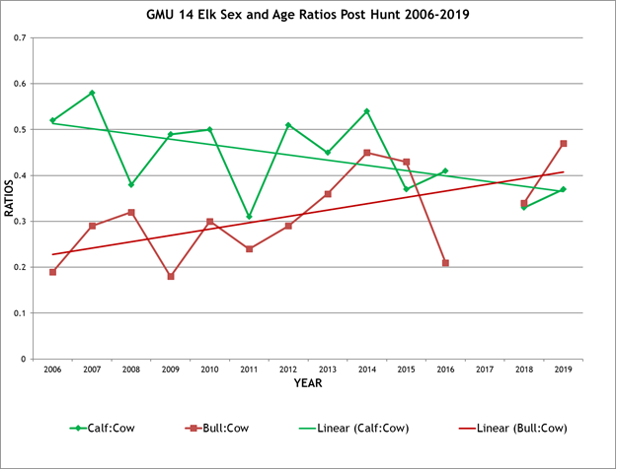
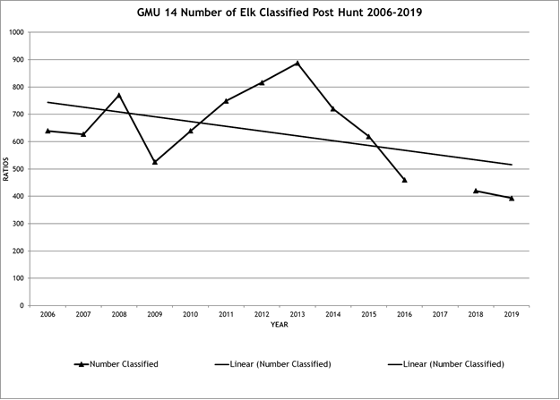
Biological Reasons – Classifications and Ratios

Slide 5
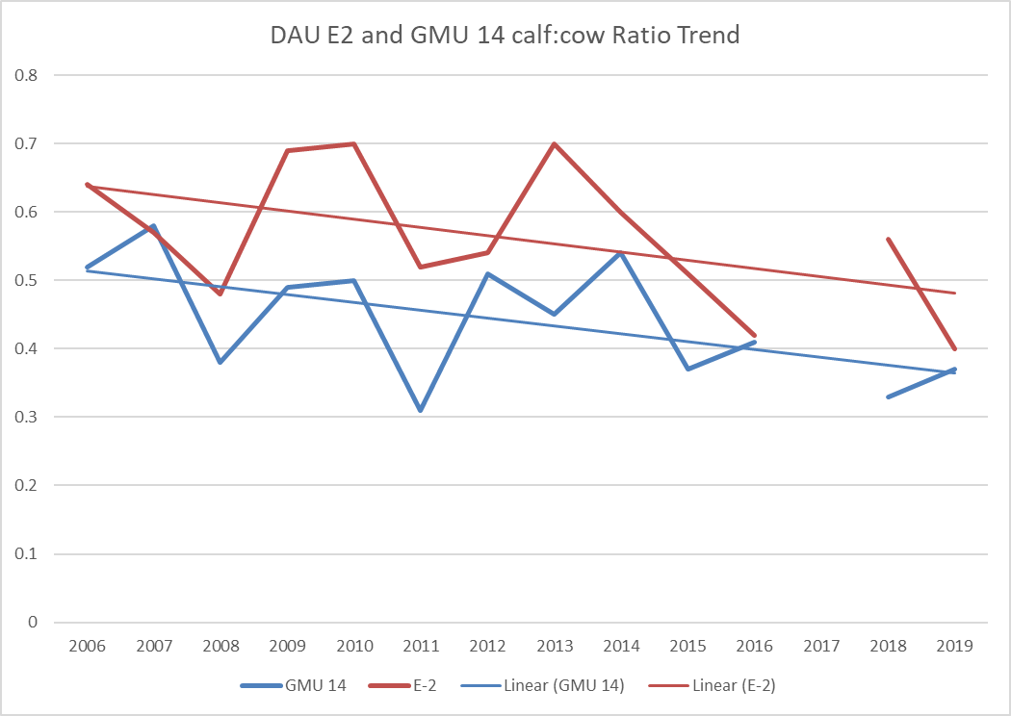
DAU E-2 and GMU 14 calf:cow

Slide 6
Biological Reasons – Harvest Trends

Slide 7
Social Overcrowding – Increasing Archers
7-8 years ago, biologists started fielding complaints about too many archery hunters and crowding in GMU 14
  Between 2010 and 2013, archery licenses numbered between 1,000 and 1,071.
Public Meeting in Steamboat Springs 2019 – 60 attendees
  12% not concerned with hunter crowding
  12% somewhat concerned with hunter crowding
  40% very concerned with hunter crowding
  23% do not hunt during the archery deer and elk seasons
2018, the number of archers surpassed the number of rifle hunters in GMU 14 and that trend continued in 2019
  1st rifle limited elk licenses, 2nd rifle season OTC, 3rd rifle season sees little rifle hunting pressure due to weather and migrations.

Slide 8
Social Overcrowding - Recreation
Buffalo Pass Usage
  Backcountry skiing, snowmobiling, snowshoeing
  Increased camping leading to expansion of Dry Creek Campground*
  Improvement of Buffalo Pass Road*
  Expansion of Steamboat Ski Resort – Pioneer Ridge*
  * = Currently engaged in the NEPA Process
Run Rabbit Run
  100-mile, 36-hour continuous footrace.
  Occurs over miles of Elk Summer Concentration Areas
  Participation increased 528% since 2007 (80 participants up to 502)
  Race takes place during the archery and muzzleloader overlap.
  Area 10 staff has met with race organizers and the U.S. Forest Service to discuss timing – no other time to have the race due to activity in Steamboat throughout the summer and into fall.

Slide 9
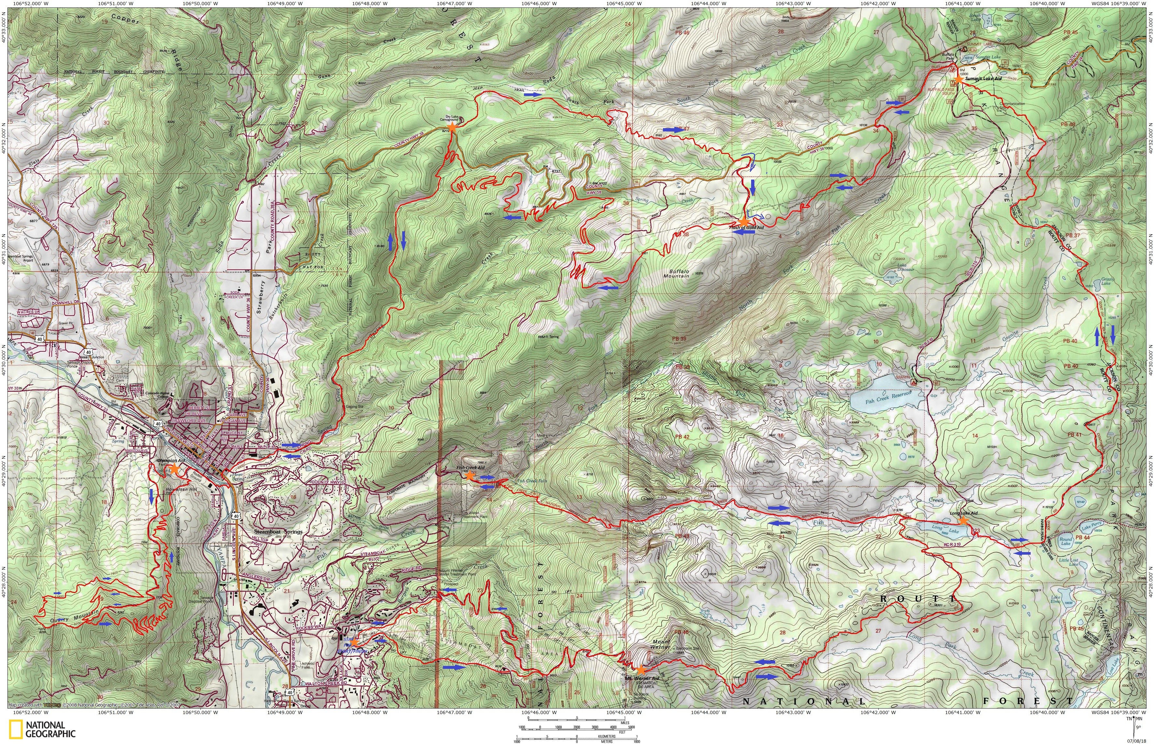

Slide 10
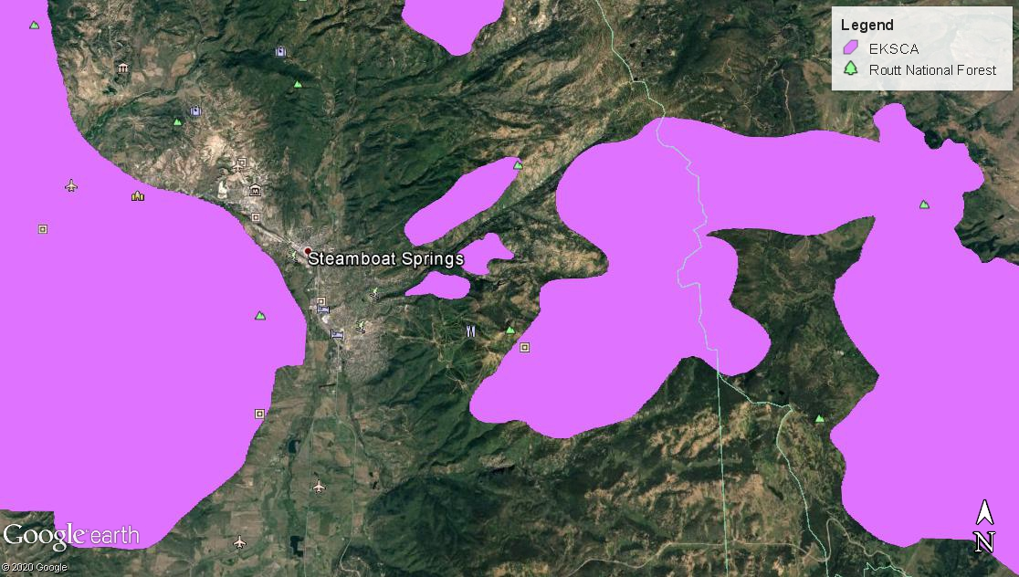

Slide 11
Alternatives
1) *Preferred Alternative*: Convert GMU 14 to a limited licensing unit for archery elk and establish available licenses at 1,000 either-sex licenses beginning in 2021.
2) Convert GMU 14 to a limited licensing unit for archery elk and establish available licenses at 600 either-sex licenses.
3) Status quo.

